Slide 1
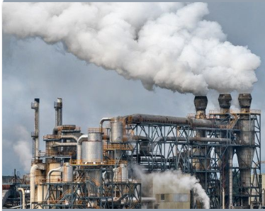


CARBON DIOXIDE EMISSION
Transforming Daily Habits for Our Planet
Presented by
www.reallygreatsite.com
DENNIS MWAMU

Slide 2

RESEARCH QUESTIONS
The industry type that had the most amount of CO2 emission in metric tonnes
The sector with highest amount of CO2 emission in metric tonnes.
Country and region with the most CO2 emission.
Region and country with the highest GDP in billion USD as aresult of the evolution of industries.
Region and country with the highest percentage of renewable energy.

Slide 3
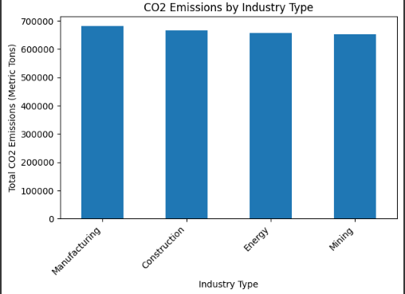
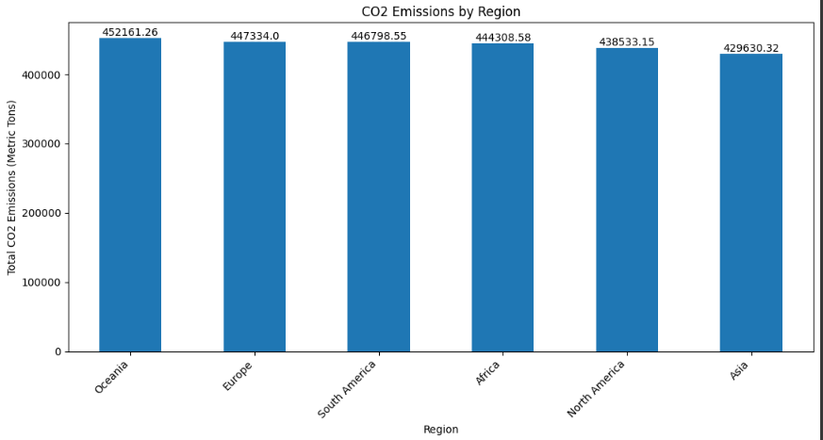

GRAPHICAL REPRESENTATIONS.

Slide 4

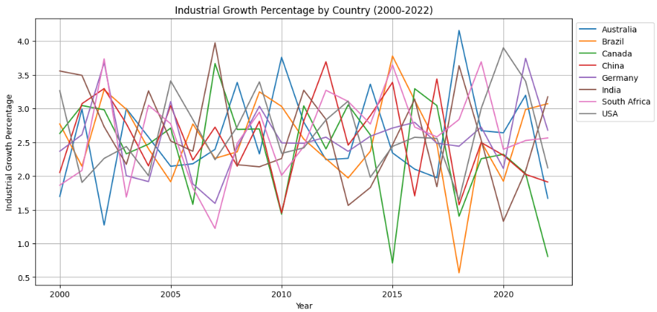


Slide 5
FINDINGS
From the research and analysis done the following findings were discovered;
1) Manufacturing industry had the largest amount of CO2 emmission in metric tonnes followed by cnstruction, energy and mining industries.
2) Brazil had the highest CO2 emmission in metric tonnes followed by Germany, Canada,India, USA,China and South Africa.
3) Oceania, Europe, South America, Africa, North America and Asian regions had the highest CO2 emmissions in terms of regions respectively.
4) Brazil, Australia, SA, Canada, Germany, India, USA and China had the highest GDP in billion USD as a result of evolution of industries.
5) Oceania region had the highest percentage of renewabe energy as compared to North America which had the least.
RECOMMENDATIONS.
1) Transition to Renewable Energy-Renewable energy sources produce little to no greenhouse gases, offering a sustainable alternative to fossil fuels.
2) Sustainable Manufacturing Practices-this includes improving energy efficiency, using recycled materials, and reducing waste.
3) Promote Public Transportation-to reduce carbon emission because o many auto mobiles.
4) Sustainable Construction-Construction industries should explore and adopt sustainable building materials and techniques
5) Carbon Capture and Storage-carbon capture and storage can play a crucial role in reducing emissions from industriies
6) International Collaboration- This can accelerate the global transition to a low-carbon economy.

